Slide 1


Siddaganga Institute of Technology, Tumakuru
(An Autonomous Institution Affiliated to vishveshvaraya technological university,Belagavi,Approved by
AICTE,NewDelhi,Accredited by NAAC and ISO 9001:2015 certified)
Presentation on
SMART PARKING SYSTEM
Presented by
1) Nitesh kumar V – 1SI20EC122 2) Yathish kumar H R – 1SI20EC118
3) Usama Ahamed – 1SI20EC117 4) Preetham G M - 1SI20EC121
5) Mithun J B - 1SI20EC124 6) Sachin Chimmalagi – 1SI20EC131
DEPARTMENT OF ELECTRONICS AND COMMUNICATION ENGINEERING
2021-2022

Slide 2
CONTENTS
Abstract
Introduction
Scope
Objectives
Hardware & Software Requirement
Advantages
Result expected
References

Slide 3
ABSTRACT
Parking is becoming one of the most common issues, it may be a Mall or a Theater, before entering the parking check if theirs any space!
It has Raspberry Pi is used as a core, as a prototype 4 parking slots are present. For detection of vehicle IR Sensor is used and to have special identity RFID is used for every new car.
The database is maintained for every visitor.
For the smart parking system, everything should be turned into autonomous like auto-detection of car entering ,leaving the park , slots availability etc.

Slide 4
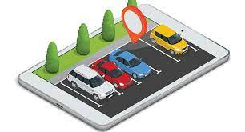
INTRODUCTION
The proposed smart car parking system will overcame all the challenges & difficulties that are there in conventional car parking system.
Smart car parking system will be a revolutionary change in the city life, which is so filled with automobiles.

Slide 5
SCOPE
Parking management system utilizes IOT and RFID, that the user utilize parking areas proficiently, reducing time to search the free parking spaces.
Smart parking solutions enable the municipalities to manage and reduce parking search traffic on the streets. This technology also ensures parking safety, but its major contribution to traffic congestion are the factors of making the parking experience faster, more convenient and hassle-free.

Slide 6
OBJECTIVES
To develop an user friendly parking system which reduces the man power and time saving .
To offer safe and secure parking slots with in the limited areas.
To reduce traffic mess caused by an unplanned parking system

Slide 7
Hardware Requirements:
Raspberry Pi
RFID Tag Reader
RFID Tags
IR Sensors
Servo Motor
LED Lights

Slide 8
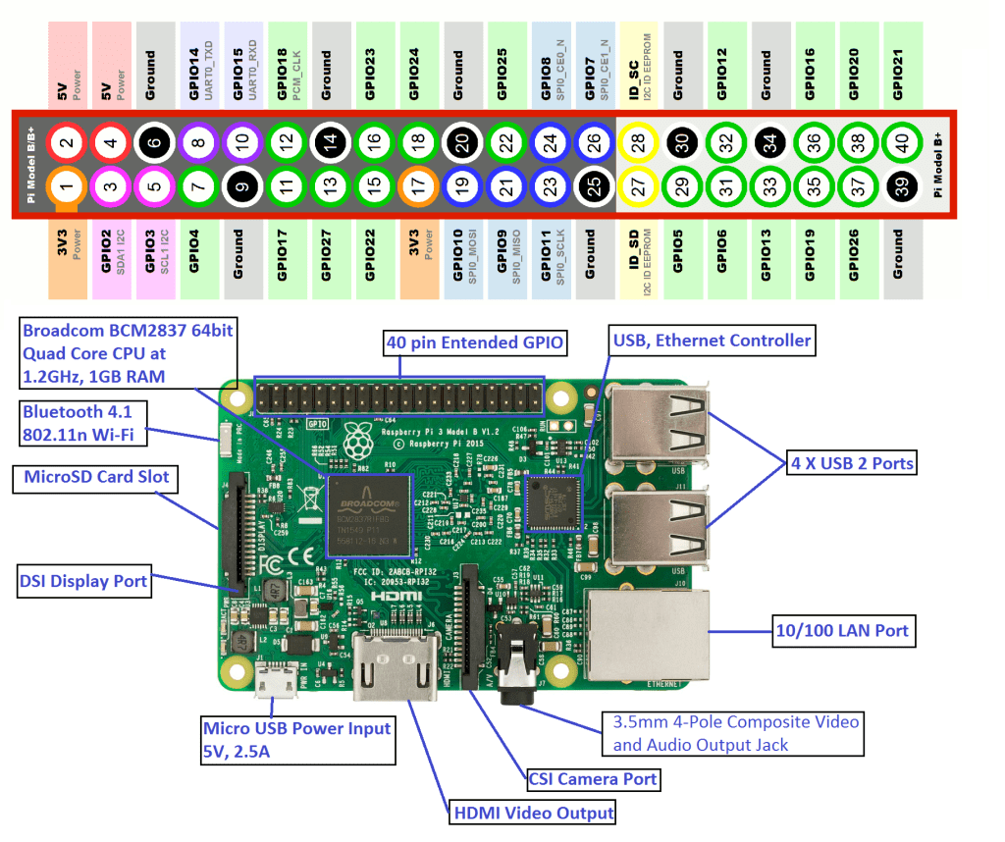
Raspberry Pi

Slide 9
Description
Raspberry Pi is the name of a series of single-board computers made by the Raspberry Pi Foundation, a UK charity that aims to educate people in computing and create easier access to computing education.
By connecting peripherals like Keyboard, mouse, display to the Raspberry Pi, it will act as a mini personal computer
Raspberry Pi is popularly used for real time Image/Video Processing, IoT based applications and Robotics applications
Raspberry Pi is slower than laptop or desktop but is still a computer which can provide all the expected features or abilities, at a low power consumption
You can develop many projects with raspberry pi. Many parameters such as portability, ability to produce integrated solutions, ram memory, internet connection, processor speed are the strengths of raspberry pi

Slide 10
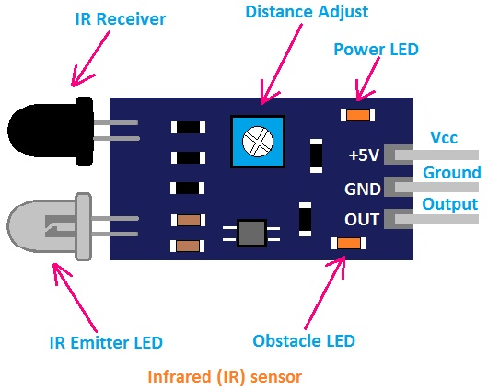
IR SENSOR

Slide 11
Working Principle
An infrared (IR) sensor is an electronic device that measures and detects infrared radiation in it’s surrounding environment
There are two types of infrared sensors
1) Active Sensor
2) Passive Sensor
When an object comes close to the sensor, the infrared light from the LED reflects off of the object and is detected by the receive
There are different types of infrared transmitters depending on their wavelengths, output power and response time
Specifications :
1) The operating voltage is 5VDC
2) I/O pins – 3.3V & 5V
3) Mounting hole
4) The range is up to 20 centimeters
5) The supply current is 20mA
6) The range of sensing is adjustable
7) Fixed ambient light sensor

Slide 12
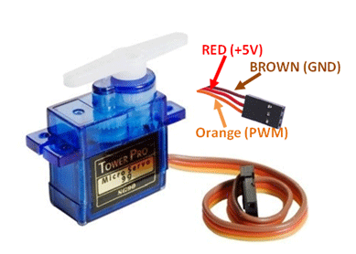
SERVO MOTOR

Slide 13
Working Principle
Servo motor works on PWM (Pulse width modulation) principle, means its angle of rotation is controlled by the duration of applied pulse to its Control PIN
Basically servo motor is made up of DC motor which is controlled by a variable resistor (potentiometer) and some gears
The servo motors usually have a revolution cut off from 90° to 180°. A few servo motors also have a revolution cutoff of 360° or more. But servo motors do not rotate constantly. Their rotation is limited between the fixed angles.
Servo motors are used to lift the gates at the entry and exit of the parking area.

Slide 14
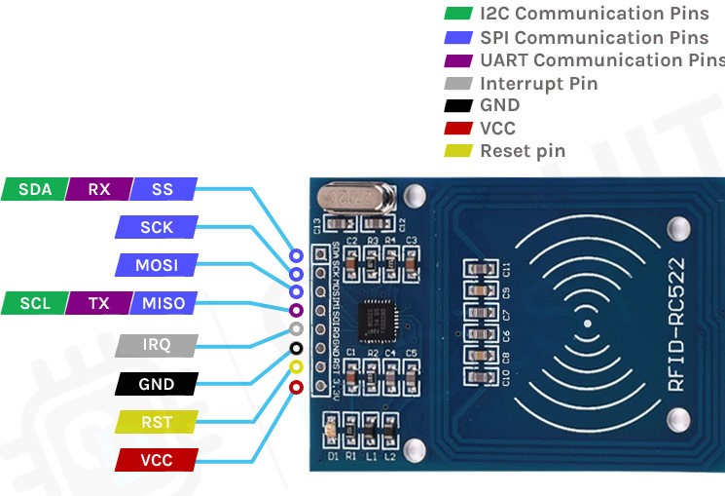
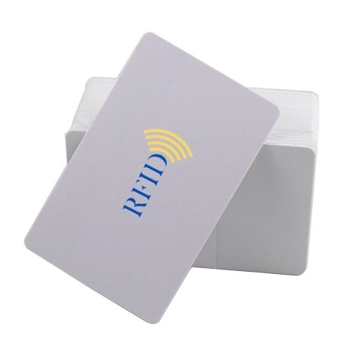
RFID-RC522

Slide 15
Working Principle
RC522 is the highly integrated RFID card reader which works on non-contact 13.56mhz communication
It is designed by NXP as low power consumption, low cost and compact size read and write chip
The RFID system is comprised of two components : The RFID reader and the tags.
RFID tags are a type of tracking system that uses radiofrequency to search, identify, track, and communicate with items and people.
Specification :
1) 13.56MHz contactless communication card chip.
2) Working current：13 – 26mA / DC 3.3V
3) Working frequency：13.56MHz
4) Card reading distance ：0～60mm

Slide 16
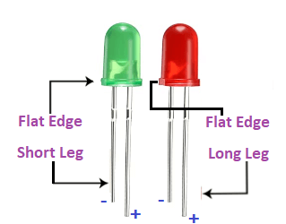
LED LIGHTS

Slide 17
Working Principle
LED (Light Emitting Diode) work on the principle Electroluminescence.
On passing a current through the diode, minority charge carriers and majority charge carriers recombine at the junction.
On recombination, energy is released in the form of photons.
LED lighting products produce light up to 90% more efficiently than incandescent light bulbs
The working principle of the LED can be understood from the energy bandgap theory. This theory states that the ability to release photons upon the electron-hole pair recombination depends upon the bandgap of the semiconductors.

Slide 18
Software Requirements:
MQTT
Android Studio
Raspbian OS with libraries installed
PUTTY
Machine Learning

Slide 19
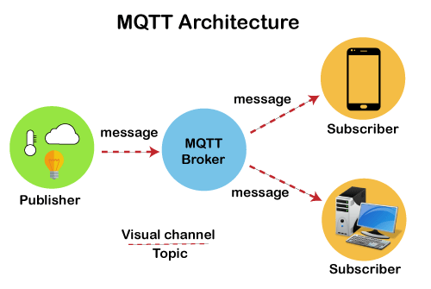
MQTT

Slide 20
Description
MQTT ( Message Queue Telemetry Transport) is a lightweight, publish-subscribe, machine to machine network protocol for Message queue/Message queuing service
It is designed for connections with remote locations that have devices with resource constraints or limited network bandwidth.
It must run over a transport protocol that provides ordered, lossless, bi-directional connections—typically.
The MQTT protocol defines two types of network entities: a message broker and a number of clients.
An MQTT broker is a server that receives all messages from the clients and then routes the messages to the appropriate destination clients.
An MQTT client is any device (from a micro controller up to a fully-fledged server) that runs an MQTT library and connects to an MQTT broker over a network.

Slide 21

PUTTY
PUTTY is a free and open-source terminal emulator, serial console and network file transfer application.
It supports several network protocols including SCP, SSH, Telnet, rlogin, and raw socket connection.
It can also connect to a serial port.
PuTTY is an alternative to telnet clients. Its primary advantage is that SSH provides a secure, encrypted connection to the remote system.

Slide 22

Android Studio
Android Studio is the official integrated development environment (IDE) for Android application development.
It is based on the IntelliJ IDEA, a Java integrated development environment for software, and incorporates its code editing and developer tools.
Android Studio provides a unified environment where you can build apps for Android phones, tablets, Android Wear, Android TV, and Android Auto.

Slide 23
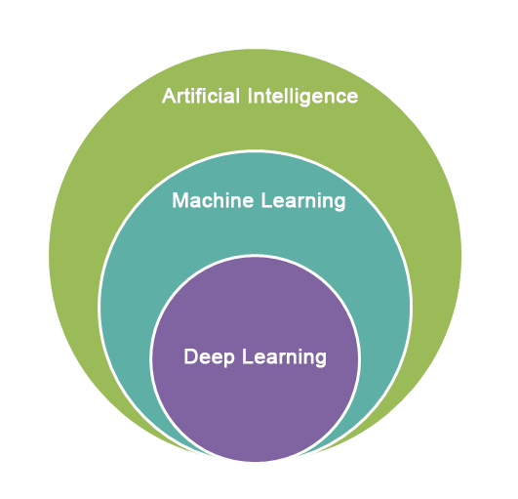
Machine Learning
Machine learning is a branch of artificial intelligence (AI) and computer science which focuses on the use of data and algorithms to imitate the way that humans learn, gradually improving its accuracy.
Machine learning is a method of data analysis that automates analytical model building.

Slide 24
Project Description
It first detects the vehicle parked in slots and shows the status
of each slot through the webserver. Visitors can know the status of the parking slot through the webpage, after that they have to show their RF ID to the reader to get authenticated and note down the time of that specific vehicle. If the new visitor is detected through a new RF reader, then it prompts to ask the username, password and Mail ID with their RF-ID and store those details to the Raspberry Pi. Then while leaving, by showing the RF ID to the reader

Slide 25
Advantages
Reduce Search Traffic on Streets
Reduced traffic
Reduced pollution
The user can know in real time parking availability in every single way, with the indication of the number of free parking space available.
Increased Safety and Securit
Easy implementation and management
Cost-effective
Uses integrated software and applications
The system provides details of the vacant parking slots in the vicinity and reduces the traffic issues due to illegal parking in the vicinity

